Slide 1
OOP

Slide 2
Bank Account

Slide 3
Bank Account Deposit
Download the Back Account File
Add a function deposit() to deposit some money into your account
Sample Usage:
>>> myAcc = BankAccount('Alan',1000)
>>> myAcc.showBalance()
Your balance is $1000
>>> myAcc.deposit(200)
>>> myAcc.deposit(400)
>>> myAcc.showBalance()
Your balance is $1600

Slide 4
Bank Account Secure Withdraw
Add a control measure when you withdraw
You must provide your name when you withdraw and it must match your name in the account
>>> myAcc = BankAccount('Alan',1000)
>>> myAcc.withdraw('Mary',100)
You are not authorized for this account
>>> myAcc.withdraw('Alan',10000)
Money not enough! You do not have $10000
0
>>> myAcc.withdraw('Alan',100)
100
>>> myAcc.showBalance()
Your balance is $900

Slide 5
Bank Account Compute Interest
Add an attribute for interest rate
And initialize it at the constructor
Implement a function “oneYearHasPass()” such that you gain the interest in your balance:
>>> myAcc = BankAccount('Alan',1000,0.04)
>>> myAcc.showBalance()
Your balance is $1000
>>> myAcc.oneYearHasPass()
>>> myAcc.showBalance()
Your balance is $1040.0
>>> myAcc.oneYearHasPass()
>>> myAcc.showBalance()
Your balance is $1081.60

Slide 6
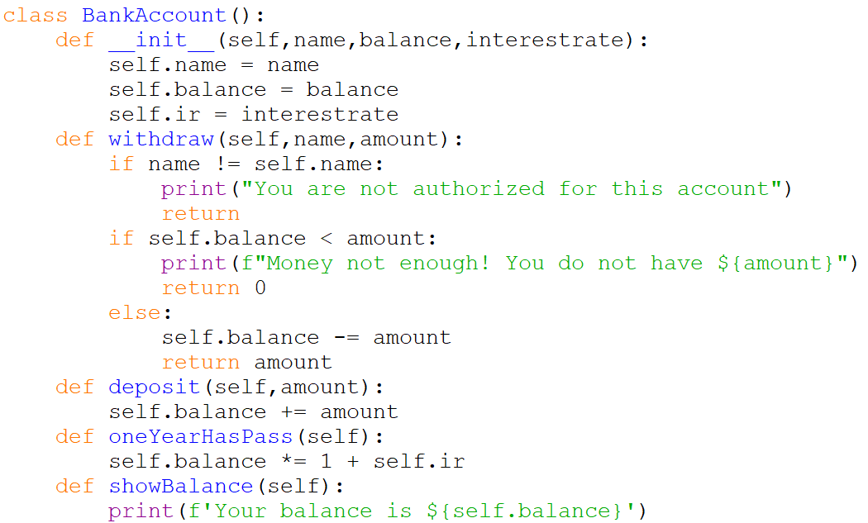
Overall Solution

Slide 7
Minimal Account
Define a new class of bank account called MinimalAccount
This class will be the same as the normal BankAccount, except
If one year has pass, and your account is less than $1000, $20 dollars of administration fee will be deducted from your account.
Unless the balance will be less than zero, then reset to zero
The fee will be deducted BEFORE the calculation of interest

Slide 8
Sample Run
>>> mySonAcc = MinimalAccount('John',40,0.04)
>>> mySonAcc.oneYearHasPass()
>>> mySonAcc.showBalance()
Your balance is $20.8
>>> mySonAcc.oneYearHasPass()
>>> mySonAcc.showBalance()
Your balance is $0.8320000000000007
>>> mySonAcc.oneYearHasPass()
>>> mySonAcc.showBalance()
Your balance is $0.0

Slide 9
Minimal Account
Define a new class of bank account called MinimalAccount
This class will be the same as the normal BankAccount, except
If one year has pass, and your account is less than $1000, $20 dollars of administration fee will be deducted from your account.
Unless the balance will be less than zero, then reset to zero
The fee will be deducted BEFORE the calculation of interest
Discuss with your neighbor, how will you design this class?
Direct modification to BankAccount? Or
Duplicate BankAccount and modify it? Or…
What else?

Slide 10
Home Challenge
method TransferTo() in class BankAccount
Given another account, you can transfer your money to another, e.g.
>>> myAcc.transferTo(myWifeAcc,500)
method setupGiro() in class BankAccount
Money will be deducted every year before interest
>>> myAcc = BankAccount(‘Alan’,1100,0.04)
>>> myAcc.setupGiro(40)
>>> myAcc.setupGiro(60)
>>> myAcc.oneYearHasPass()
>>> myAcc.showBalance()
Your balance is $1040
A new class JointAccount
An account has two names, anyone of them can withdraw

Slide 11
Vehicles

Slide 12
Recap: Lecture
Vehicle
Attributes: pos,velocity
Methods: setVelocity(),move()
Canon
Attributes: numAmmo
Methods: fire()
Sportscar
Methods: __init__(), turnOnTurbo()
Lorry
Attributes: cargo
Methods:__init__(),load(),unload(),inventory()
Tank
Bisarca
Methods: load()

Slide 13
More Realistic
Let’s try to be more realistic
Every vehicle need some petrol
Sportscar, Lorry, etc.
A new method called addPetrol(n) will add n liters of petrol into a vehicle
And for every “move”, the vehicle will use 1 liter of petrol
What attribute do you need to add? And where?
>>> myCar.addPetrol(2)
>>> myCar.move()
Move to (0, 80)
>>> myCar.move()
Move to (0, 160)
>>> myCar.move()
Out of petrol. Cannot Move.
>>> myCar.addPetrol(1)
>>> myCar.move()
Move to (0, 240)
>>> myCar.move()
Out of petrol. Cannot Move.

Slide 14
Add where?
Vehicle
Attributes: pos,velocity
Methods: setVelocity(),move()
Canon
Attributes: numAmmo
Methods: fire()
Sportscar
Methods: __init__(), turnOnTurbo()
Lorry
Attributes: cargo
Methods:__init__(),load(),unload(),inventory()
Tank
Bisarca
Methods: load()

Slide 15
Add Red and Modify Green
Vehicle
Attributes: pos,velocity,petrol
Methods: setVelocity(),move(),addPetrol()
Canon
Attributes: numAmmo
Methods: fire()
Sportscar
Methods: __init__(), turnOnTurbo()
Lorry
Attributes: cargo
Methods:__init__(),load(),unload(),inventory()
Tank
Bisarca
Methods: load()

Slide 16
Try To Implement the Petrol Feature

Slide 17
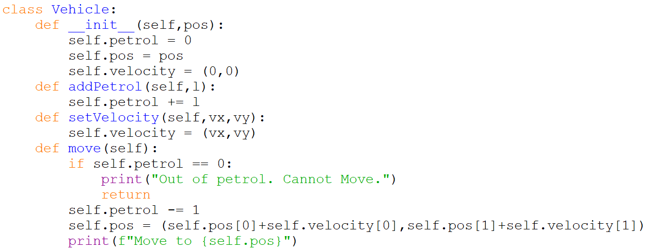
Vehicle That Needs Petrol

Slide 18
Design Issue
How about a Tank that can survive on solar power?
Don’t need petrol

Slide 19
How to Design a Solar Tank?
Vehicle
Attributes: pos,velocity,petrol
Methods: setVelocity(),move(),addPetrol()
Canon
Attributes: numAmmo
Methods: fire()
Sportscar
Methods: __init__(), turnOnTurbo()
Lorry
Attributes: cargo
Methods:__init__(),load(),unload(),inventory()
Tank
Bisarca
Methods: load()

Slide 20
Solution?
Separate the current “petrol” vehicle into
A superclass Vehicle and a Subclass PetrolVehicle
Then the solar tank will be a subclass of both Vehicle and Cannon

Slide 21
Vehicle
Attributes: pos,velocity
Methods: setVelocity(),move()
PetrolVehicle
Attributes: petrol
Methods: addPetrol()
Canon
Attributes: numAmmo
Methods: fire()
Sportscar
Methods: __init__(), turnOnTurbo()
Lorry
Attributes: cargo
Methods:__init__(),load(),unload(),inventory()
Tank
SolarTank

Slide 22
Try To Implement the SolarTank after PetrolVehicle

Slide 23
Solution?
Separate the current “petrol” vehicle into
A superclass Vehicle and a Subclass PetrolVehicle
Then the solar tank will be a subclass of both Vehicle and Cannon
Get into Trouble with
SolarBattleBisarca
You are forced to re-implement a SolarBisarca first? or…?

Slide 24
You want the “load()” in Bisarca but don’t want petrol
PetrolVehicle
Attributes: pos,velocity,petrol
Methods: setVelocity(),move(),addPetrol()
Canon
Attributes: numAmmo
Methods: fire()
Sportscar
Methods: __init__(), turnOnTurbo()
Lorry
Attributes: cargo
Methods:__init__(),load(),unload(),inventory()
Tank
Bisarca
Methods: load()

Slide 25
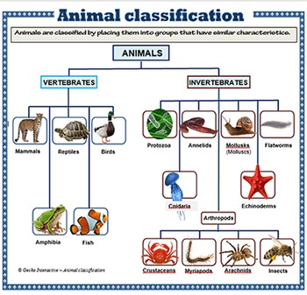
Design Issue
If every class can be classified nicely, the world is beautiful
Every subclass is a subset of its superclass
Every subclass in the same level is distinct
Not like …

Slide 26
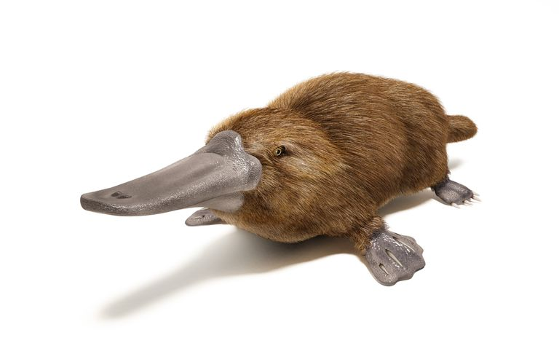
Design Issue
Where will you fit platypus into the classification?

Slide 27
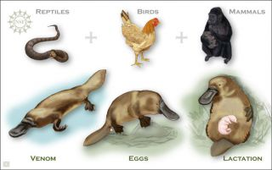
Where will you fit platypus ?
Platypus
Got venom like reptiles
Lay eggs like birds
Milk like Mammals

Slide 28

Design Issue
Where will you fit platypus into the classification?

